Slide 1

BERDBOT
The world’s most useful useless discord bot

Slide 2
What is This thing exactly?
Berdbot is a discord bot
Its main job is to remind us when our friends’ birthdays are
It also has a bird themed mini game

Slide 3
Bird themed game?
It displays a picture of a bird
The first person to type !catch catches the bird
A running total of each person’s bird total is kept in a database.

Slide 4
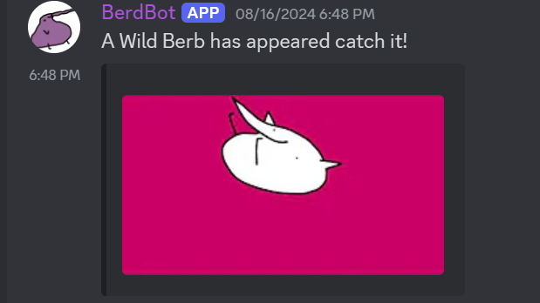
Example of bird catching
All typos are intentional

Slide 5
Finding Bottlenecks
We created a command that just spams posts.
Discord’s API rate limits after 3 messages/second
SQLite

Slide 6
Getting around bottlenecks
We delayed the number of messages Berdbot can send per second to ensure that we don’t get rate limited by Discord.
Redis Cache to ensure that the messages are all sent.

Slide 7

Solving the issue of crashing
Berdbot crashes sometimes
We added a message whenever Berdbot Shuts down
This tells us that someone needs to deploy Berdbot again.

Slide 8
Ensuring data remains consistent across crashes
Suggestions from the class?
(It’s okay to ask for ideas from your classmates during your presentation. The finished project is the one you submit. This is just meant to be an overview of the technologies involved)
Cloud host suggestions?

Slide 9
